Slide 1

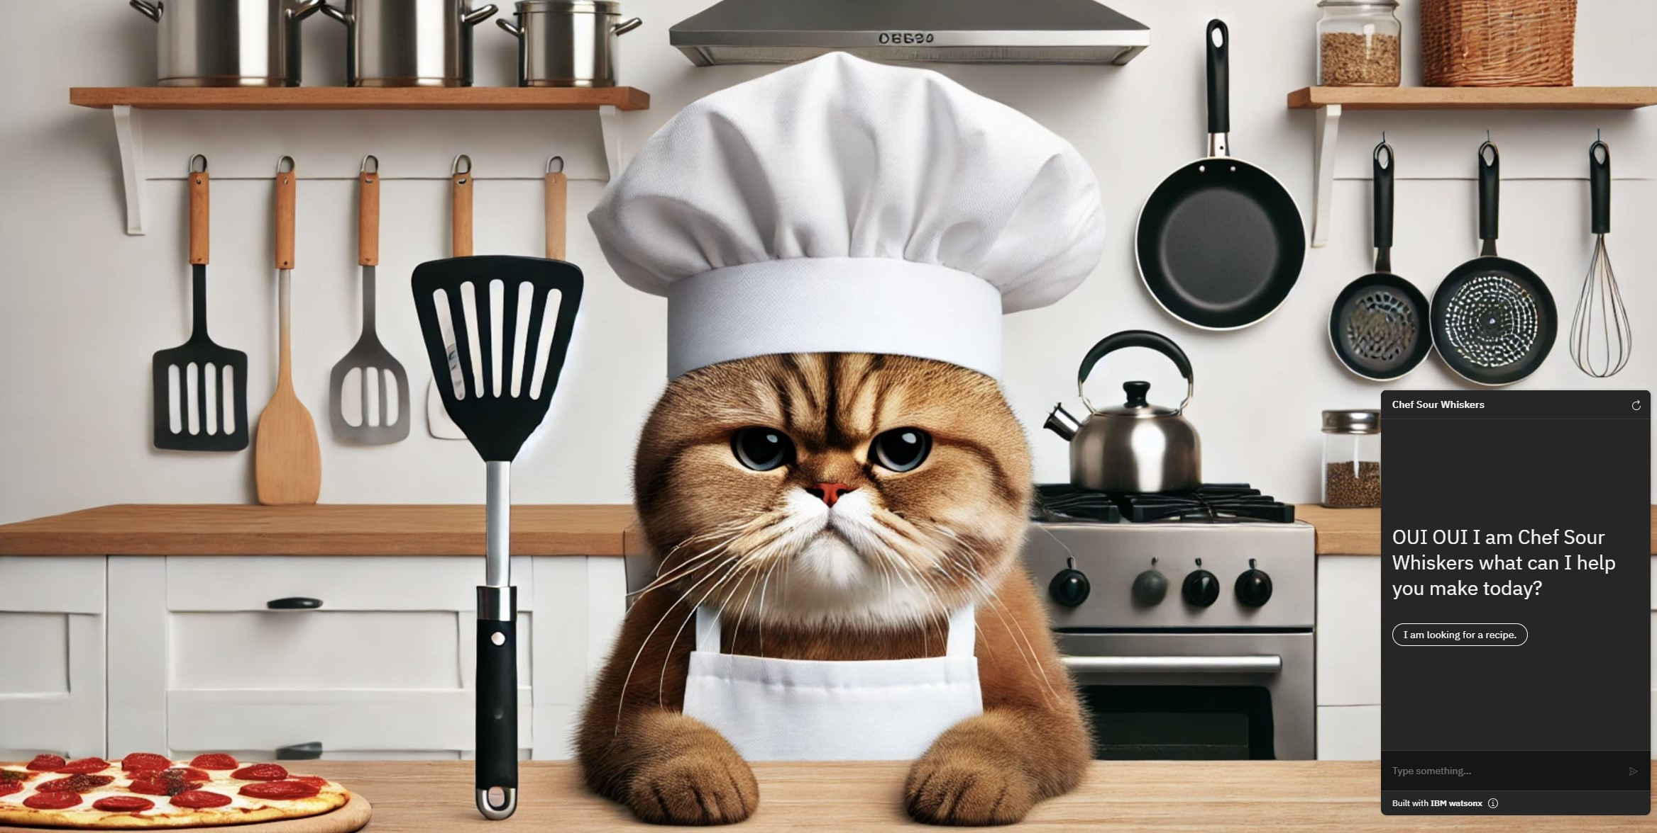
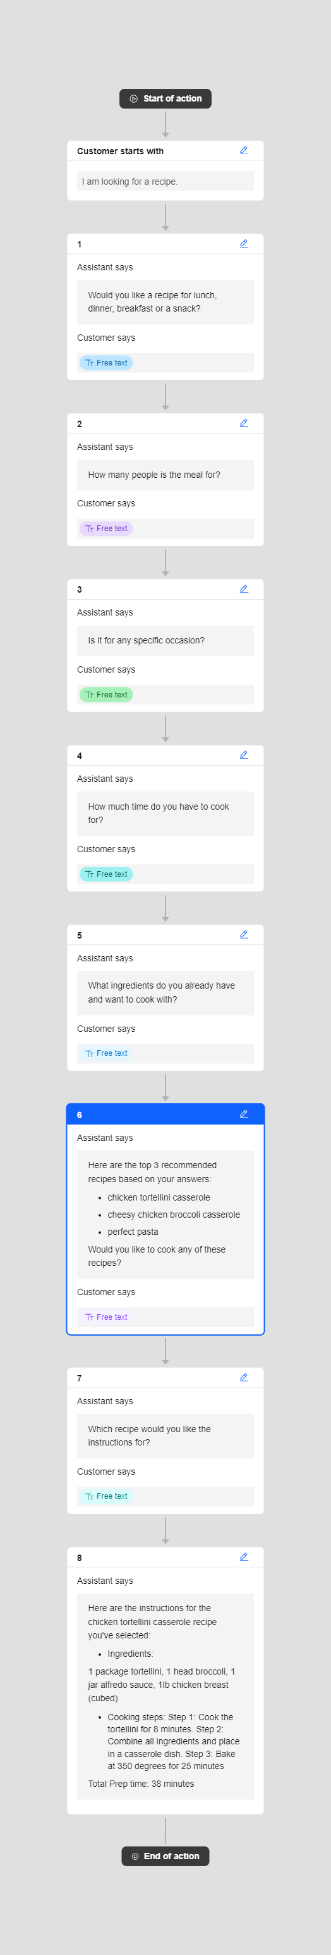
Culinary Companion
Sarah Thuman, Syed Aziz, Olivia Fellbaum
Business Challenge
The goal is to reverse the traditional recipe book model.
Instead of searching for a recipe to find the ingredients, users will input the ingredients they already have or want to cook with, along with other information such as the occasion, the number of servings needed, and more.
Architecture
Results
User provides ingredients they already have at home along with other details about the meal they want to cook, and the Culinary Companion provides a list of recipes that meet their requirements. After the user selects which recipe they want to cook, the instructions for the recipe are provided to the user.
Food.com Recipe Database
Culinary Companion Chatbot built using IBM Watson. This chatbot is on Homepage. Initial Conversation with Customer.
Data Collected from Chat
Cosine Similarity algorithm to match user inputs with database entries and filtering.
Output with recommended recipes
User selects a recipe from the list and then the chatbot provides the recipe instructions
Data and Scope
The user input will be the ingredients available, type of cuisine desired, number of servings, occasion, and the amount of time it takes to prep the meal.
The recipe data is sourced from Kaggle (Food.com Recipes and Interactions)
This data set contains ingredient lists, tags that describe the recipe, time it takes to cook the recipe, and cooking instructions for about 232,000 recipes.
Next Steps
Incorporate allergies and recipe scaling into recommendations.
Customize recipe recommendations based on occasion.
Conclusion
The Culinary Companion AI tool aims to solve the common problem of deciding what to cook with available ingredients, thereby reducing food waste and making meal preparation more enjoyable
Both individual users and companies in the culinary space, offering a valuable tool for everyday cooking and enhancing user engagement on recipe platforms.
http://www.stevens.edu/school-business/masters-programs/business-intelligence-analytics

